Slide 1
Introduction to Psychology
Delivered by
Amna Nisar
Clinical Psychologist
Speech and language pathologist

Slide 2
Introduction to Psychology
Chapter 3
Motivation and Theories of Motivation

Slide 3
Motivation
Motivation represents forces acting within a person that cause a person behave in a specific goal directed manner.
The willingness to exert high level of effort to reach organizational goals, conditioned by the effort’s ability to satisfy some individual needs.

Slide 4
Motivation
The psychological feature that arouses an organism to action toward a desired goal; the reason for the action; that which gives purpose and direction to behavior.
Motivation is the set of reasons that determines one to engage in a particular behavior.

Slide 5
Motivation is one of the important factors in learning. Without motivation, not much or no learning at all will take place.

Slide 6

In totality, it is the process of arousing and sustaining interest in an activity in order to achieve a goal.

Slide 7
Importance of Motivation
Directs activities towards the achievement of a goal.
Controls and directs human behavior.
Inculcates spiritual and moral values in the minds of the young.
Gives satisfaction and happiness to the individual.

Slide 8
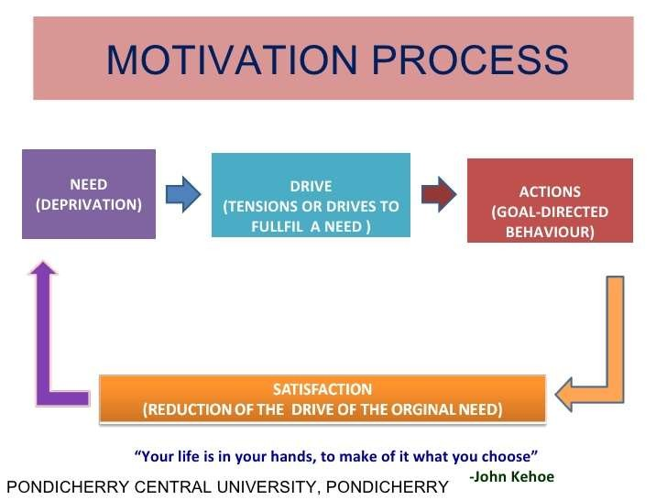
Second stage
First stage
Motive
Third stage

Slide 9
MOTIVATION AS DIFFERENTIATED FROM MOTIVE AND INCENTIVE
A disposition, tendency, desire, or aspiration
A drive or impulse, an attitude that arouses interest, and sustains and regulates behavior.
It is internal, within an individual , has a definite goal to achieve

Slide 10
Incentive
An external benefit or reward of some kind derived from an activity.
May come in the form of social approval as praise, good grades, honors, scholarships, medals, and the like.

Slide 11
Types of Motivation
Intrinsic Motivation
Extrinsic Motivation

Slide 12

Intrinsic Motivation
An internal stimulus that arouses one to action. It is based on motive, which is always intrinsic. A motive arouses one to do something.
Ex. If a learner wants to solve a mathematical problem however difficult it is, he can solve it correctly. He feels elated and with self-fulfillment.

Slide 13
Extrinsic Motivation
An external stimulus to action. This type of motivation is based on incentive. This type of motivation comes from the outside of the individual, that is, from the external environment.
It comes from the form of praise, social approval, high grades, medals and the likes.

Slide 14
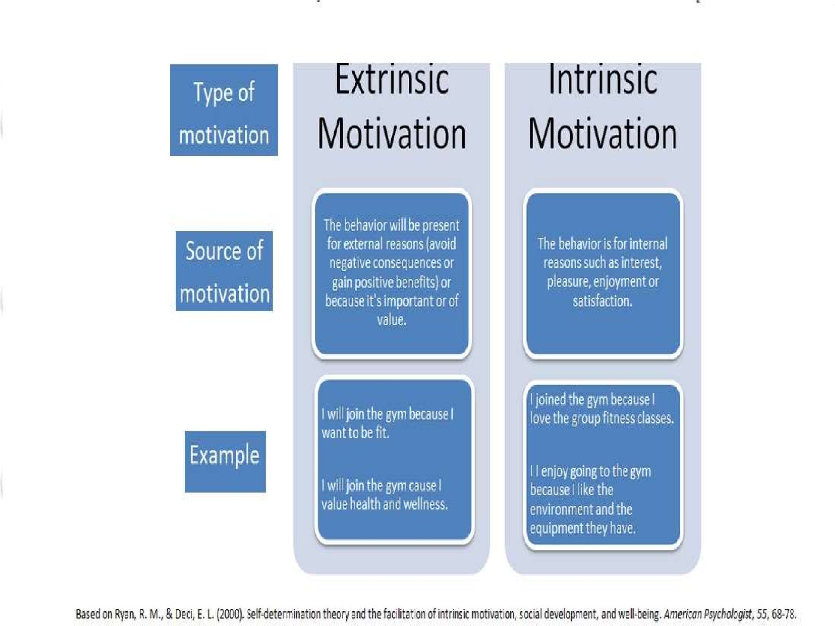


Slide 15
Maslow’s hierarchy of need
(Humanistic Approach)

Slide 16
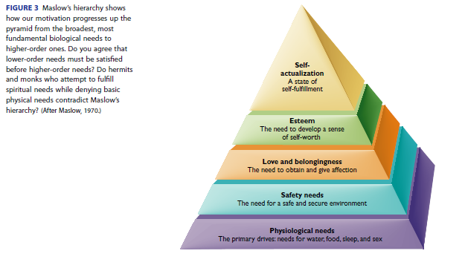

Slide 17
Physiological
These refer to basic physical needs, such as drinking when thirsty or eating when hungry. According to Maslow, some of these needs involve our efforts to meet the body’s need for homeostasis; that is, maintaining consistent levels in different bodily systems. For example, food.
Safety
Once people’s physiological requirements are met, the next need that arises is a safe environment. Our safety needs are apparent even early in childhood, as children have a need for safe and predictable environments and typically react with fear or anxiety when these needs are not met. For example, shelter.

Slide 18
Love and Belonging
According to Maslow, the next need in the hierarchy involves feeling loved and accepted. This need includes both romantic relationships as well as ties to friends and family members. It also includes our need to feel that we belong to a social group. For example, relationships.
Esteem
Our esteem needs involve the desire to feel good about ourselves. According to Maslow, esteem needs include two components. The first involves feeling self-confidence and feeling good about oneself. When people’s esteem needs are met, they feel confident and see their contributions and achievements as valuable and important.
Self-Actualization
Self-actualization refers to feeling fulfilled, or feeling that we are living up to our potential. One unique feature of self-actualization is that it looks different for everyone. For one person, self-actualization might involve helping others.

Slide 19
Herzberg Two factor Theory by Frederick Herzberg 1950s

Slide 20
Herzberg's Two-Factor Theory
Herzberg's Two-Factor Theory, also known as the Motivation-Hygiene Theory, distinguishes between factors that create job satisfaction (Motivators) and factors that prevent dissatisfaction (Hygiene factors).
Herzberg's theory emphasizes that to enhance employee motivation and satisfaction, employers should focus on adequately addressing hygiene factors to avoid dissatisfaction, and simultaneously work on enhancing motivators to foster job satisfaction and motivation. This approach suggests a dual strategy for improving work conditions and employee attitudes.

Slide 21
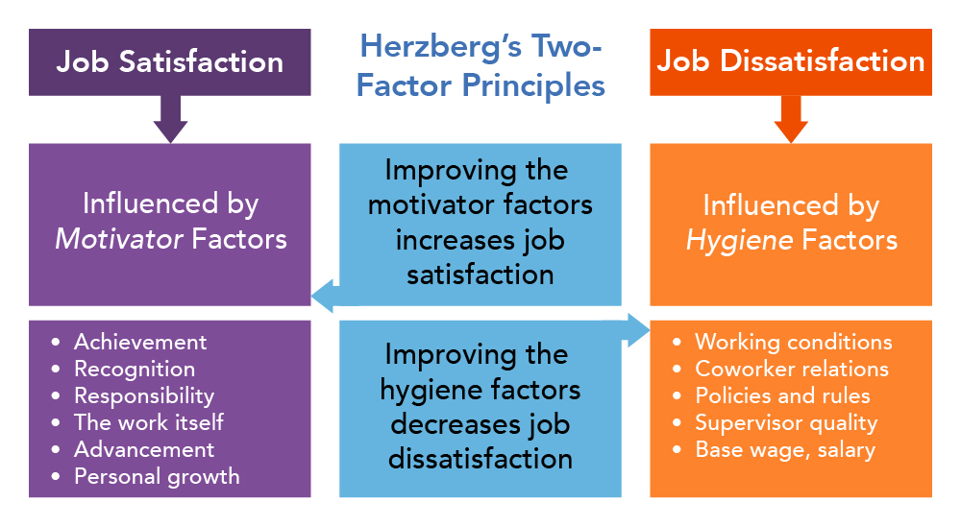

Slide 22
TYPES OF MOTIVES
BIOLOGICAL MOTIVES
Oxygen
Hunger
Thirst
Sex
Avoidance of Pain
Temperature regulation
Bladder tension
Fatigue

Slide 23
Oxygen:
oxygen is the most basic need of every living being without it no one can survive.

Slide 24
2. Hunger:
Role of stomach cues
Role of the brain
Eating Disorders
1. Obesity
2. Anorexia Nervosa
3. Bulimia

Slide 25
3. Thirst:
Thirst is the regulation of fluid intake
Biological regulation of thirst
a “drink” and a “stop drinking” center are located in different sections of the hypothalamus
homeostatic
Dehydration
Blood loss also cause thirst.

Slide 26
4. Sex Motive:
The biological need for sex is an unusual physical motive in such an individual can survive an entire lifetime without once satisfying it,but this need is Important for survival of the human race.
Role of hormones

Slide 27
5. Avoidance from pain:
Every one wants to get rid of pain.

Slide 28
6. Temperature regulation:
This is obtained through the use of clothing, location, and the building of protecting structures. 98.6 degrees or 37degree Celsius

Slide 29
7. Bowel and Bladder tension:
All organisms create waste products via the processes of living. Much waste comes from food. The rest is produced by movement, growth, and other functions of living. If this waste remained in living things, it would soon cause illness and death. Thus living things must have a way to dispose of waste matter.

Slide 30
Fatigue.
Tiredness ,lethargy in muscles.
Types of fatigue
SLEEP.
Hypothalamus, insomnia, Time span, psychological and physical effects

Slide 31
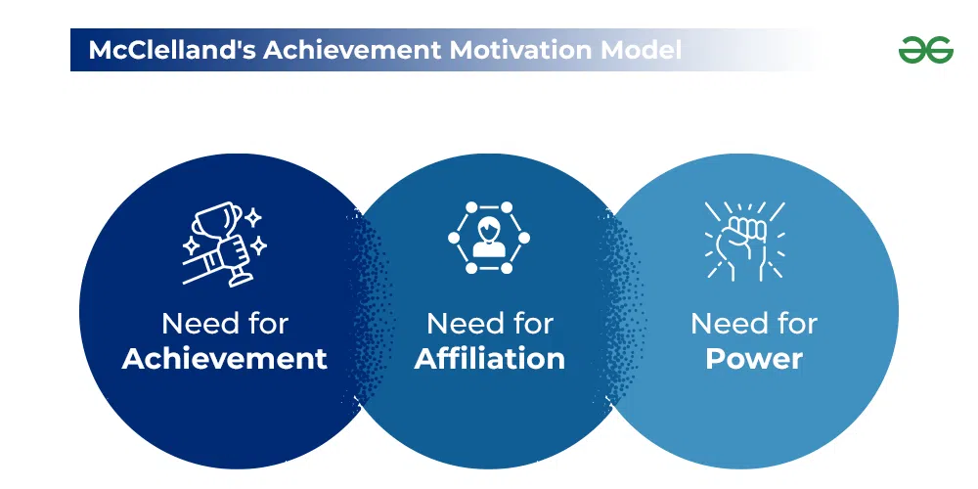
Social motives

Slide 32
Social motives
Need for achievement:
Refers to an individual's desire for significant accomplishment, mastering of skills, control, or high standards.
The need for success in competitive situations
fear of failure
failure to try because of fear you might not succeed
fear of success
snatching defeat out of the mouth of victory because of fear of success

Slide 33
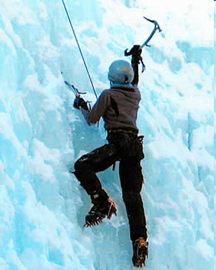

Slide 34
Need for affiliation:
The Need for Affiliation is a term that was popularized by David McClelland and describes a person's need to feel a sense of involvement and 'belonging' within a social group. Every one wants to have friends. concept of attachment

Slide 35
Need for Achievement
Highest in Maslow hierarchy
People high on Achievement are characterized by a tendency to seek challenges and a high degree of independence. Their most satisfying reward is the recognition of their achievements Need for Achievement is related to the difficulty of tasks people choose to undertake..

Slide 36
Need for power:
People who exhibit power tendencies are thought to be most satisfied by seeing their environment move in a certain direction, due to their involvements. As an example of the need for personal power, most corporate leaders seek high level positions so as to control the direction in which their company is moving.

Slide 37
Motivation Application through Goal Setting from Luthans, F. (2011). Organizational behavior: An evidence-based approach (12th ed.). McGraw-Hill.

Slide 38
Motivational application through job design from Luthans, F. (2011). Organizational behavior: An evidence-based approach (12th ed.). McGraw-Hill.

Slide 39

Motivation is the process of arousing and sustaining interest in an activity in order to achieve a goal.
Generally, the young learners do not fully realize the importance of performing well unless they are engaged in. Teachers has to provide the necessary motivating factors to achieve the desired objectives.

Slide 40
Thank you

